Slide 1
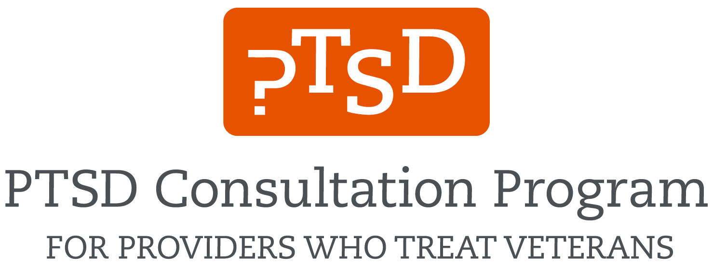



PTSD Consultation Program for providers who treat Veterans
PTSDconsult@va.gov
(866) 948-7880
www.ptsd.va.gov/consult
Notes:
As [providers] who may work with or treat Veterans and Service members with PTSD, at times it is helpful to access trusted resources or reach out to colleagues who have expertise and vast experience on military-related PTSD treatment options.
If you regularly or even occasionally treat Veterans with PTSD, there’s a new, free resource available to you from the National Center for PTSD.

Slide 2






About the Consultants
Experienced senior psychologists, psychiatrists, social workers, pharmacists, and other health professionals who treat Veterans with PTSD
Available to consult on everything from your toughest cases to general PTSD questions
Ask about:
Evidence-based treatment
Medications
Clinical management
Resources
Assessment
Referrals
Collaborating with VA on Veterans’ care
Developing a PTSD treatment program
Available Resources - www.ptsd.va.gov/consult
Free continuing education
Videos, educational handouts, and manuals
PTSD-related publications
PTSD and trauma assessment and screening tools
Mobile apps, and more
WWW.PTSD.VA.GOV
Notes:
The PTSD Consultation Program provides free email or telephone consultation with expert PTSD clinicians to providers who are treating Veterans with PTSD.
Email and phone responses are free and quick, and you can usually receive a response within a business day or less.
Any provider working with Veterans can contact the Program.
Their expert clinicians, who have an average of 17 years of experience, have designed, implemented, and led PTSD treatment programs, and consulted on thousands of cases treating PTSD. They can consult with you on everything from your toughest cases to general PTSD information. Their expertise covers areas including:
Evidence-based treatments such as Prolonged Exposure Therapy (PE), Cognitive Processing Therapy (CPT), and Eye Movement Desensitization and Reprocessing (EMDR);
prescribing for PTSD,
assessment and diagnosis,
referring to higher level of care (like residential treatment),
collaborating with VA on the care of a Veteran,
resources for Veterans and family members,
training opportunities on Veteran-related topics, and
developing clinical programming for Veterans and PTSD.
Any question related to PTSD and Veteran care is fair game.
Services provided are consistent with evidence-based practices for PTSD and VA consensus statements such as the VA/DoD Clinical Practice Guideline for PTSD. You can call or email the program to schedule a time to speak that’s most convenient for you.
The program also offers a range of other resources through their website at www.ptsd.va.gov/consult, like free continuing education, assessment tools, fact sheets, resources to share with Veterans and family members, and other PTSD-related publications.
[Insert any personal testimonial/experience about personally using the Consultation Program] OR: We can’t emphasize enough what a useful resource this is. The consultants are friendly, approachable, and responsive, and have been working in the PTSD field treating patients for years. Key program consultants include Dr. Matthew Friedman, the former Executive Director of the National Center for PTSD and Dr. Sonya Norman, the Program Director.
Please feel free to share this resource with your colleagues.
Send an email to PTSDconsult@va.gov, or call 1-866-948-7880 to set up a consultation time, or visit www.ptsd.va.gov/consult to learn more.

