Slide 1


VA/DoD Clinical Practice Guideline (CPG) for the Management of Posttraumatic Stress Disorder (PTSD) and
Acute Stress Disorder (ASD)
Key Recommendations
VA

Slide 2

CPG Qualifying Statements
Guidelines:
Are based upon the best information available at time of publication and are designed to assist decision making.
Are developed by a panel of multidisciplinary experts and based on a systematic review of both clinical and epidemiological evidence.
Provide a clear explanation of the logical relationships among various care options and health outcomes while rating both the quality of the evidence and strength of the recommendation.
Are not intended to represent TRICARE policy.
Variations in practice will inevitably occur when clinicians consider:
  The needs of individual patients
  Available resources
  Limitations unique to an institution or type of practice
VA

Slide 3
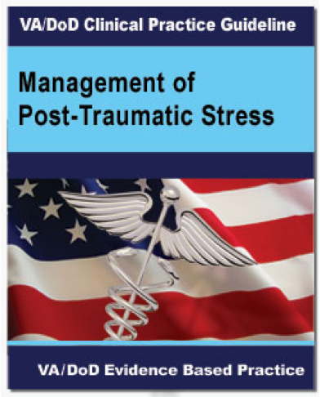
Summary of Recommendations
The major recommendations in the CPG cover the following:
  General Clinical Management
  Diagnosis and Assessment of PTSD
  Prevention of PTSD
  Treatment of PTSD
  Treatment of PTSD with Co-occurring Conditions
VA

Slide 4

Summary of Recommendations
Recommendations were made using a systematic approach considering multiple domains:
  Confidence in the quality of the evidence:
    Strong evidence = recommendation
    Weak evidence = suggestion
    Insufficient evidence = no specific guidance
  Balance of desirable and undesirable outcomes
  Patient or provider values and preferences
  Other implications, as appropriate (e.g., resource use, equity, acceptability, feasibility, and subgroup considerations)
VA

Slide 5
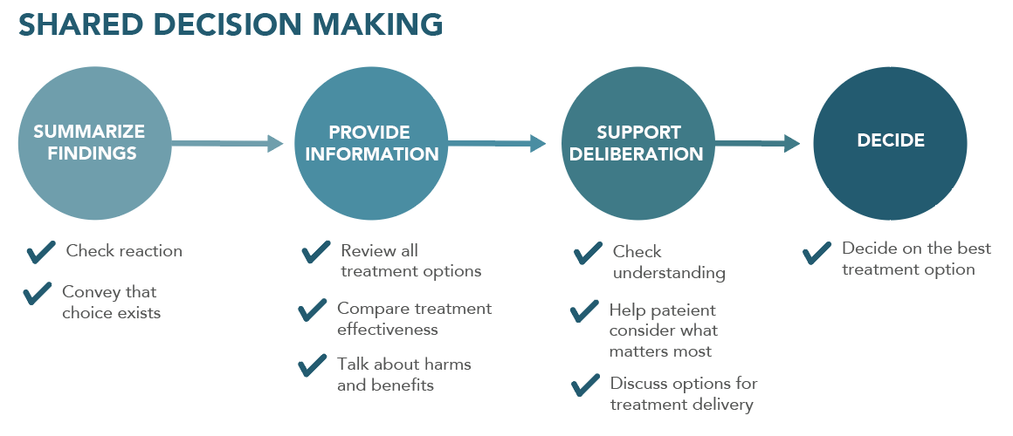
General Clinical Management
We recommend engaging patients in shared decision making, which includes educating patients about effective treatment options.
We suggest the use of collaborative care interventions that facilitate active engagement in evidence-based treatments for patients who are treated in primary care.
VA

Slide 6
Diagnosis and Assessment of PTSD
We recommend appropriate diagnostic evaluation that includes determination of DSM criteria, acute risk of harm to self or others, functional status, medical history, past treatment history, and relevant family history. A structured diagnostic interview may be considered (i.e., for patients with suspected PTSD).
We suggest periodic screening for PTSD using validated measures such as the Primary Care PTSD Screen (PC-PTSD) or the PTSD Checklist (PCL).
https://www.ptsd.va.gov/professional/assessment/screens/pc-ptsd.asp
VA

Slide 7
Diagnosis and Assessment of PTSD
We suggest for patients diagnosed with PTSD, using a quantitative self-report measure of PTSD severity, such as the PTSD Checklist (PCL-5), in the initial treatment planning and to monitor treatment progress.
PC-PTSD*
PCL-5
5 item
Self-report
Screen for PTSD in Primary Care
Positive if 3 or more YES responses
20 item
5-10 minutes
Self-report
Screen and Monitor PTSD
33 cut-point score
*PC-PTSD 4 still in CPRS
VA

Slide 8
Prevention of PTSD
We recommend for the indicated prevention of PTSD in patients with ASD, an individual trauma-focused psychotherapy that includes a primary component of exposure and/or cognitive restructuring.
There is insufficient evidence to recommend for or against use of trauma-focused psychotherapy or pharmacotherapy in the immediate post-trauma period for the selective prevention of PTSD.
There is insufficient evidence to recommend for or against use of pharmacotherapy for the indicated prevention of PTSD in patients with ASD.
VA

Slide 9
Treatment of PTSD
We recommend individual, manualized trauma-focused psychotherapy over other pharmacologic and non-pharmacologic interventions for the primary treatment of PTSD.
We recommend pharmacotherapy or individual non-trauma-focused psychotherapy when individual trauma-focused psychotherapy is not readily available or preferred. (There is insufficient evidence to recommend one over the other).
We recommend using trauma-focused psychotherapies that have demonstrated efficacy using secure video teleconferencing (VTC) modality when PTSD treatment is delivered via VTC.
VA

Slide 10
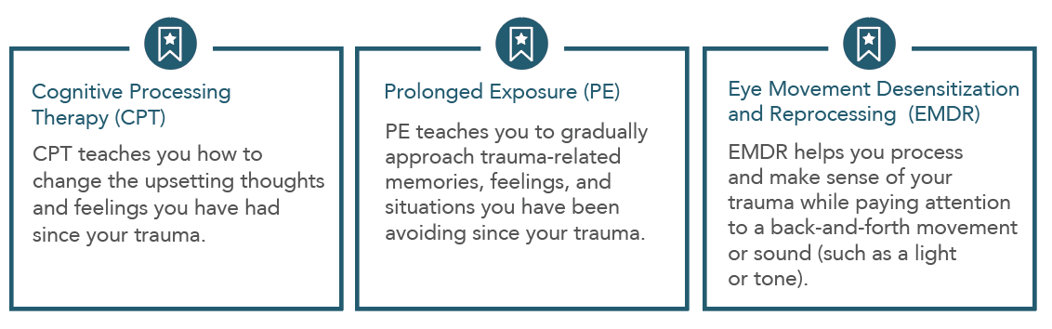
Treatment of PTSD
We recommend individual, manualized trauma-focused psychotherapies that have a primary component of exposure and/or cognitive restructuring to include Prolonged Exposure (PE), Cognitive Processing Therapy (CPT), Eye Movement Desensitization and Reprocessing (EMDR), specific cognitive behavioral therapies for PTSD, Brief Eclectic Psychotherapy (BEP), Narrative Exposure Therapy (NET), and written narrative exposure. The treatments that have the best evidence are:
VA

Slide 11
Treatment of PTSD
We suggest use of the following individual, manualized non-trauma-focused therapies: Stress Inoculation Training (SIT), Present-Centered Therapy (PCT), and Interpersonal Psychotherapy (IPT).
We suggest manualized group therapy over no treatment. There is insufficient evidence to recommend using one type of group therapy over any other.
We suggest Internet-based cognitive behavioral therapy (iCBT) with feedback provided by a qualified facilitator as an alternative to no treatment.
VA

Slide 12

Medications for PTSD
We recommend the following antidepressant medications—Sertraline, Paroxetine, Fluoxetine, and Venlafaxine—to treat PTSD.
Sertraline
Paroxetine
Fluoxetine
Venlafaxine
VA

Slide 13
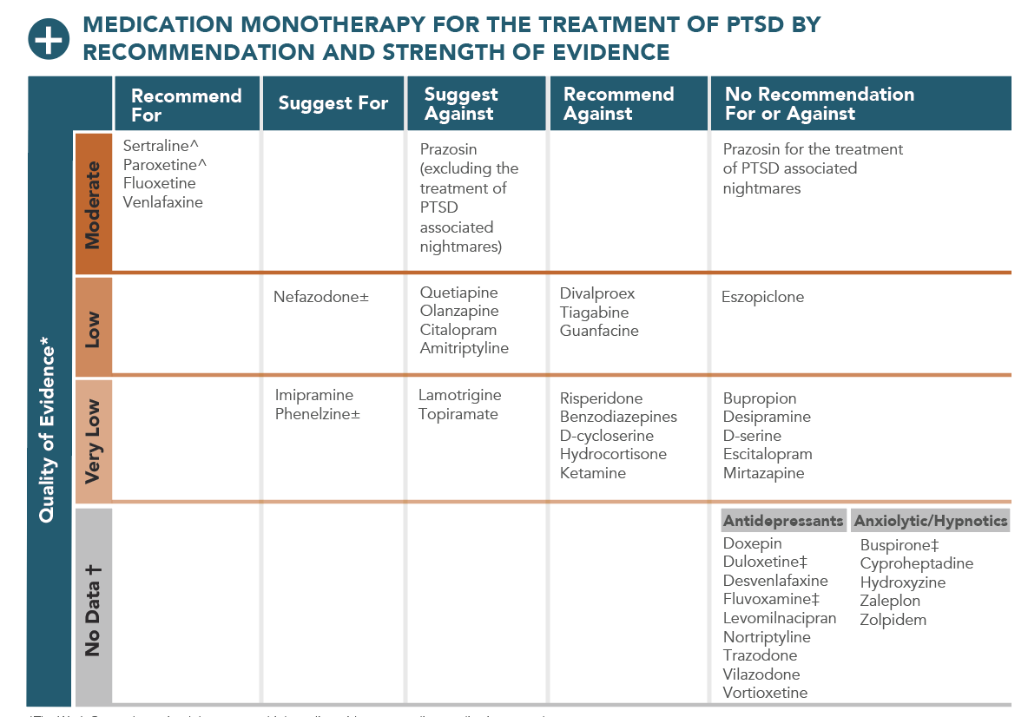
Medications for PTSD
* The Work Group determined there was no high quality evidence regarding medication monotherapy
^ FDA approved for PTSD
± Serious potential toxicity, should be managed carefully
† No data were captured in the evidence review for the CPG and were not considered in development of this table
‡ Studies of these drugs did not meet the inclusion criteria for the systematic evidence review due to poor quality
VA

Slide 14
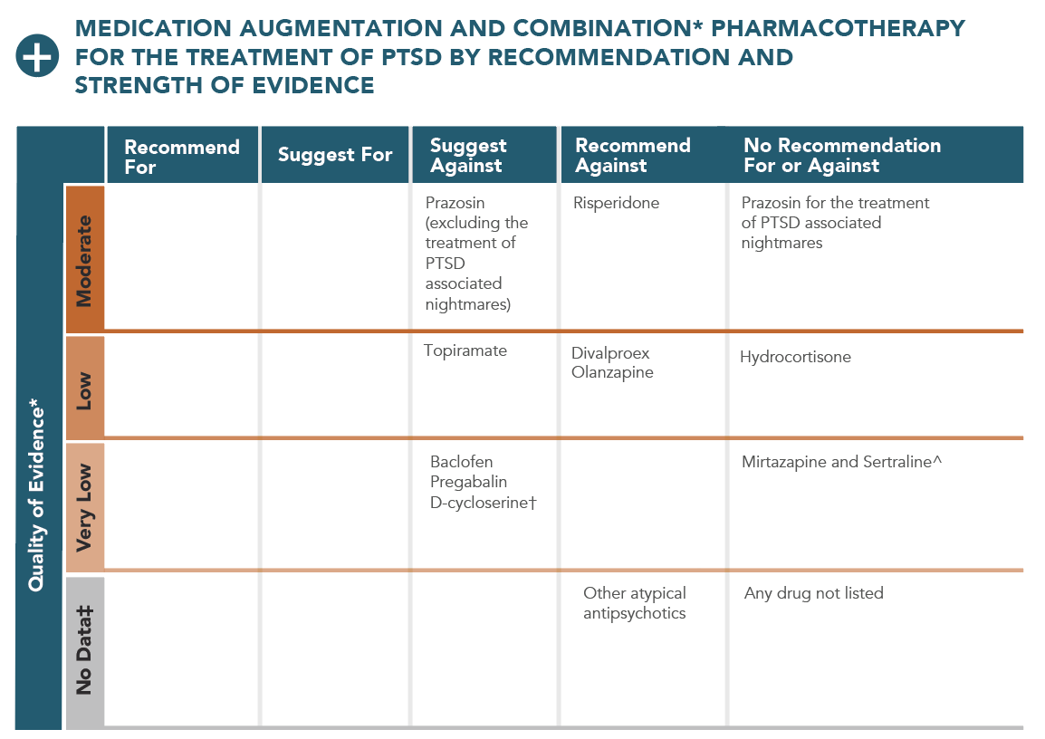
Medications for PTSD
* Combination means treatments are started simultaneously; augmentation means one treatment is started after another treatment. All treatments are augmentation unless otherwise noted.
± The Work Group determined there was no high quality evidence regarding medication augmentation and combination therapy
† Outside of a research setting
^ Combination treatment
‡ No data were captured in the evidence review for this CPG and were not considered in development of this table
VA

Slide 15
Treatment of PTSD with Co-occurring Conditions
We recommend the presence of co-occurring disorder(s) should not prevent patients from receiving other VA/DoD guideline-recommended treatments for PTSD.
We recommend VA/DoD guideline-recommended treatments for PTSD in the presence of co-occurring substance use disorder (SUD).
We recommend independent assessment of co-occurring sleep disturbances in patients with PTSD, particularly when sleep problems pre-date PTSD onset or remain following successful completion of a course of treatment.
We recommend Cognitive Behavioral Therapy for Insomnia (CBT-I) for insomnia in patients with PTSD unless an underlying medical or environmental etiology is identified or severe sleep deprivation warrants the immediate use of medication to prevent harm.
VA

Slide 16
Complementary & Integrative Health
Recommendations
There is insufficient evidence to recommend any complementary and integrative health (CIH) practice, such as meditation (including mindfulness), yoga, acupuncture, and mantram meditation, as a primary treatment for PTSD.
It is Important to clarify that we are not recommending against these treatments but at this time, the research does not support the use of any CIH practice for the primary treatment of PTSD. We recognize their value to improve wellness and promote recovery.
Grading of evidence was complicated by the heterogeneity of the types of acupuncture or meditation, for instance, that have been assessed.
No studies evaluating the use of animal-assisted therapy met the threshold for inclusion.
VA

Slide 17
How can you help?
  Tell your patient trauma-focused psychotherapy works best
  Explain that untreated PTSD can negatively impact health and enjoyment of life.
  Point out that with no treatment, symptoms are unlikely to get better and may get worse.
  Be a myth-buster: Trauma-focused psychotherapy for PTSD is not lying on a couch, won’t go on indefinitely, and is not the same as talking to a support group.
  Explore why a patient is declining referral.
  Know the recommended treatments, not just for PTSD but also for the common symptoms that you treat such as insomnia.
  Acknowledge that there are side effects to psychotherapy; it is hard work and symptoms may worsen initially.
VA

Slide 18
Learn more
Visit: www.ptsd.va.gov
Explore Treatment Options: www.ptsd.va.gov/decisionaid
Contact the PTSD Consultation Program: https://www.ptsd.va.gov/professional/consult/
VA

